Slide 1


Pizza Sales Analysis
Presented by:

Slide 2

Introduction to Pizza Sales Analysis
Pizza sales analysis is crucial for understanding customer preferences and optimizing sales strategies. Pizza Sales Analysis, a data-driven approach to understanding sales performance using MySQL queries. This project aims to explore key sales trends, customer preferences, and business insights by analyzing transactional data from a pizza restaurant.
By leveraging SQL queries, we extract valuable insights on revenue, popular pizza types, peak sales periods, and customer buying behavior. These insights help in making data-driven decisions to improve business strategies, optimize inventory, and boost overall sales.

Slide 3
DATASETS AND TABLES OVERVIEW
Orders Table
Order Details Table
Contains details of customer orders, including order ID, date, and time of purchase.
Stores information about each pizza in an order, including quantity and price.
Pizzas Table
Pizza Types Table
Lists all available pizzas with their names, sizes, and prices.
Provides details about pizza categories, ingredients, and descriptions

Slide 4
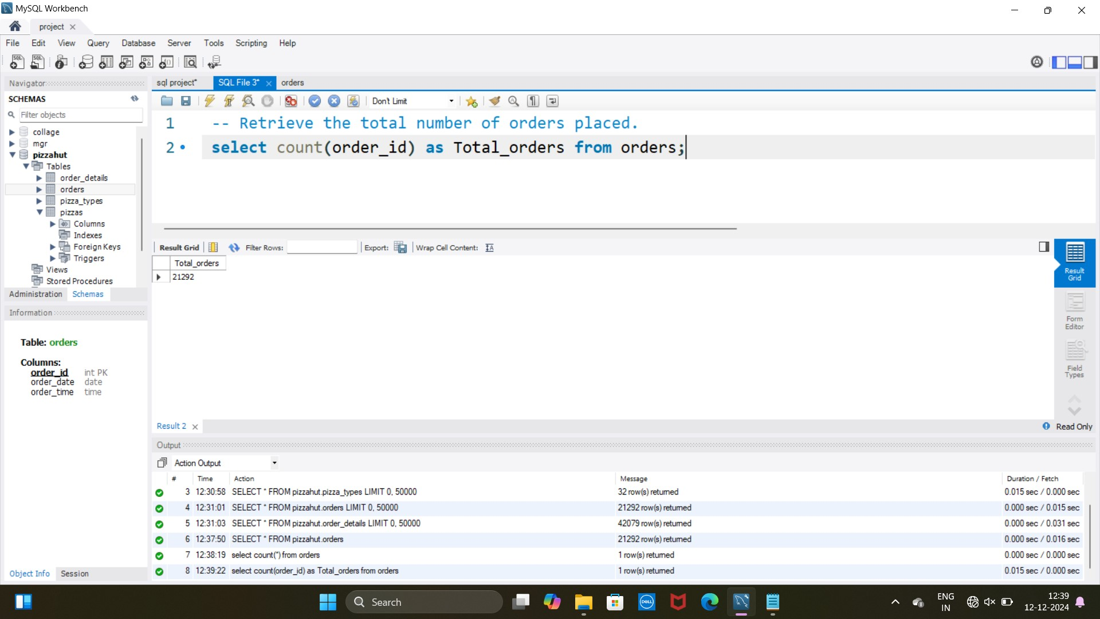
1 .Retrieve the total number of orders placed

Slide 5
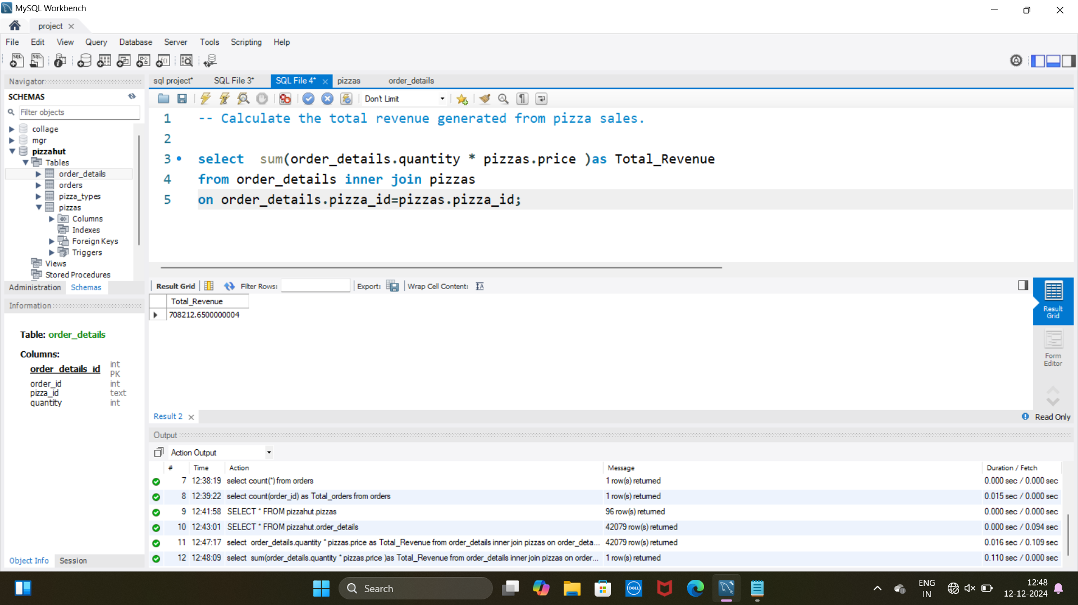
2.Calculate the total revenue generated from pizza sales

Slide 6
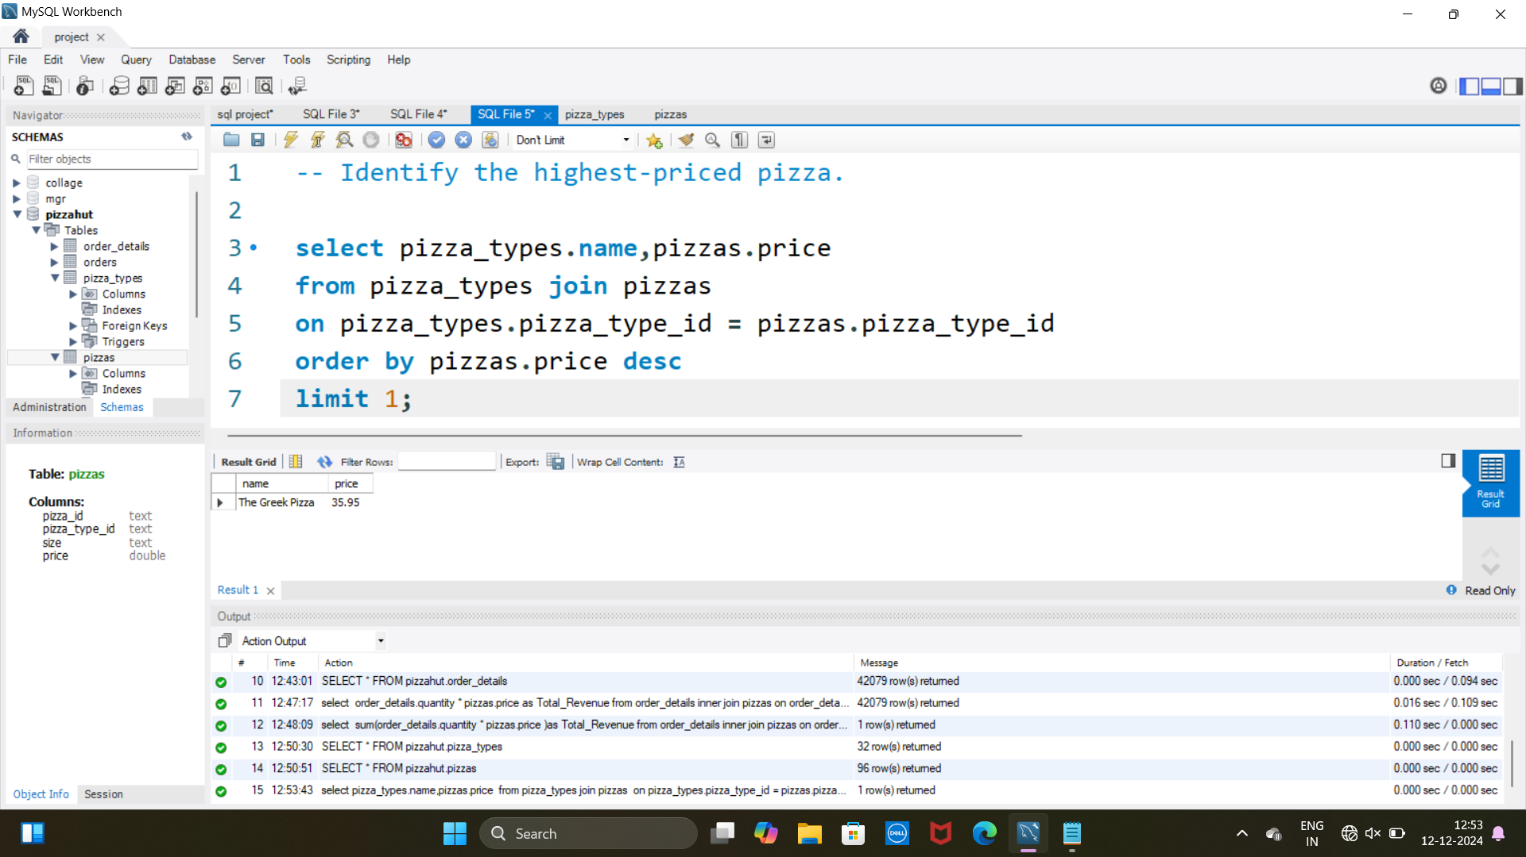
3. Identify the highest priced pizza

Slide 7
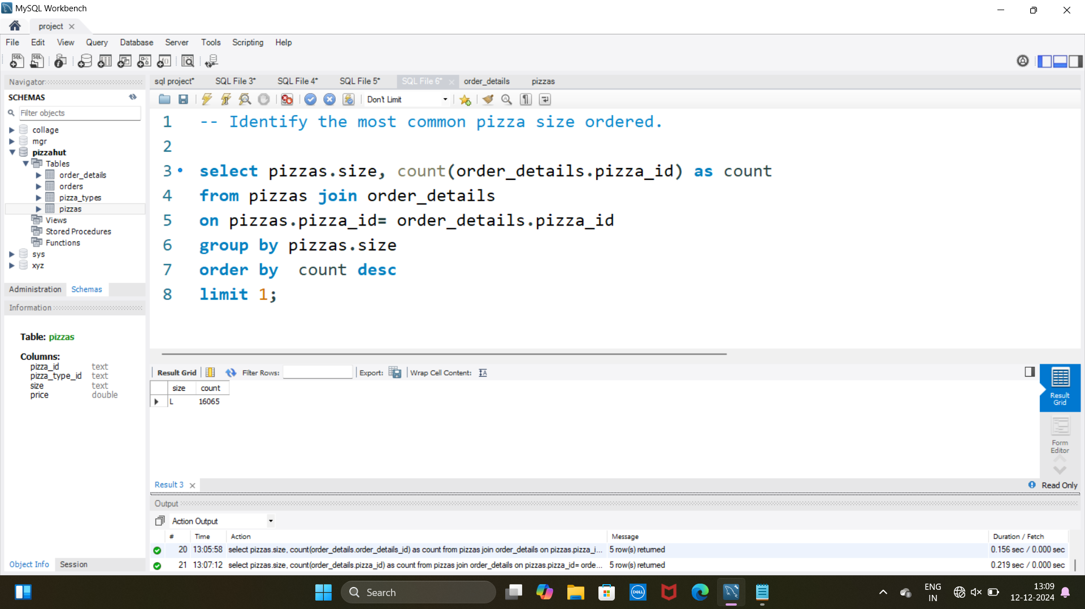
4. Identify the most common pizza size order

Slide 8
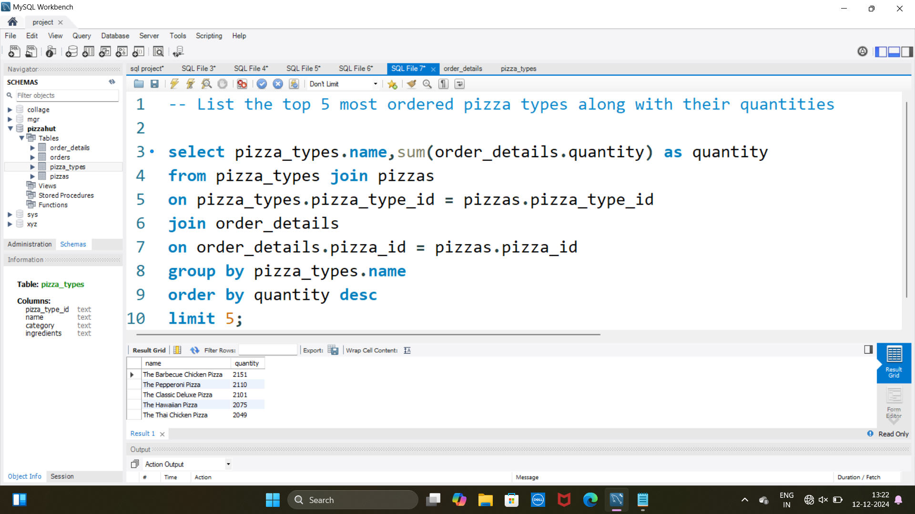
5. List the top 5 most ordered pizza types along with their quantities.

Slide 9
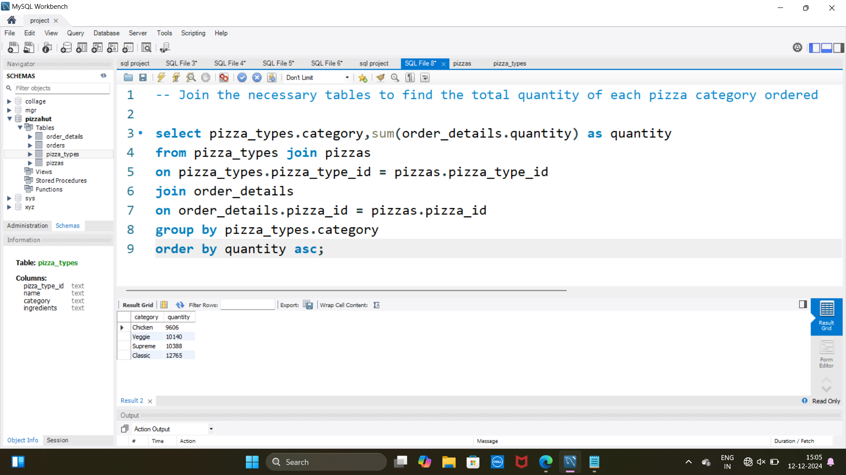
1
6. Join the necessary tables to find the
total quantity of each pizza category ordered.

Slide 10
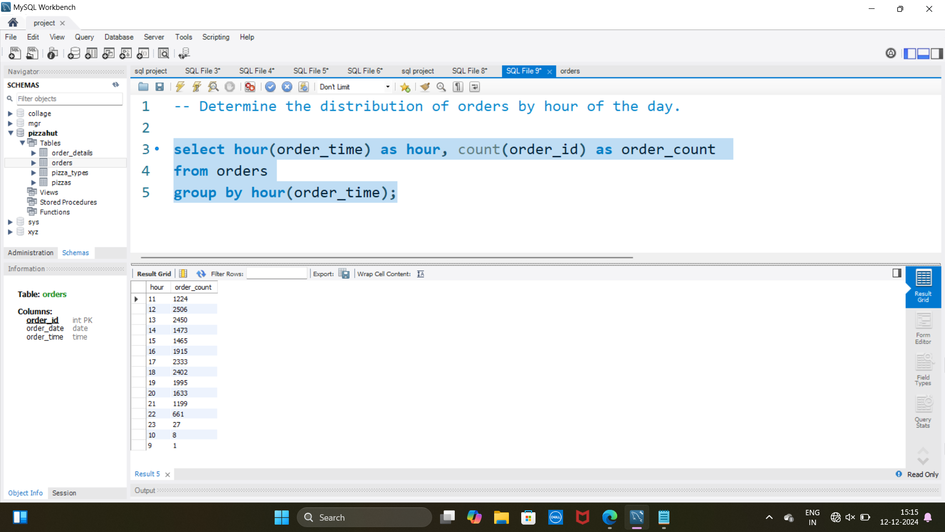
1
7. Determine the distribution of orders by hour of the day.

Slide 11
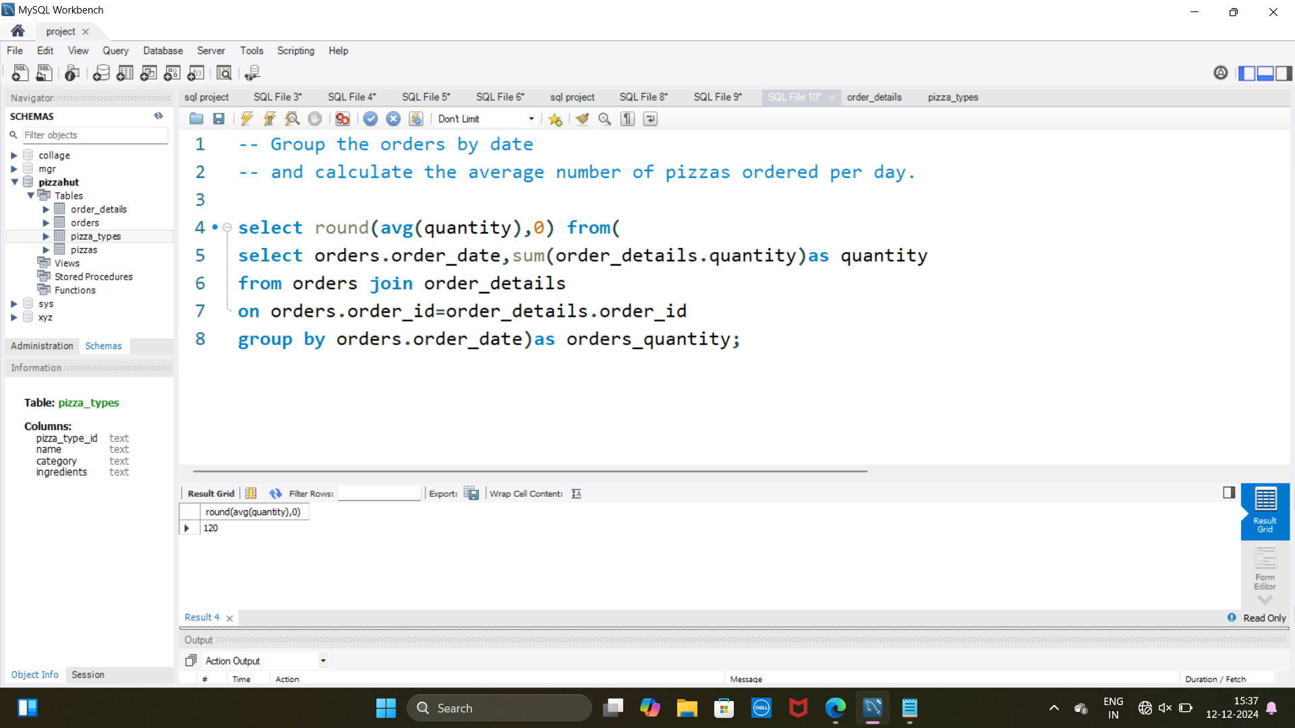
1
8. Group the orders by date and calculate the
average number of pizzas ordered per day.

Slide 12
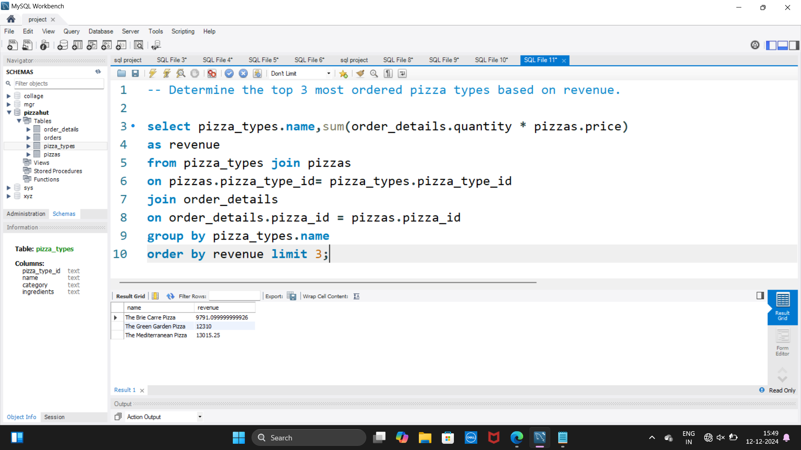
9. Determine the top 3 most ordered pizza types based on revenue.

Slide 13
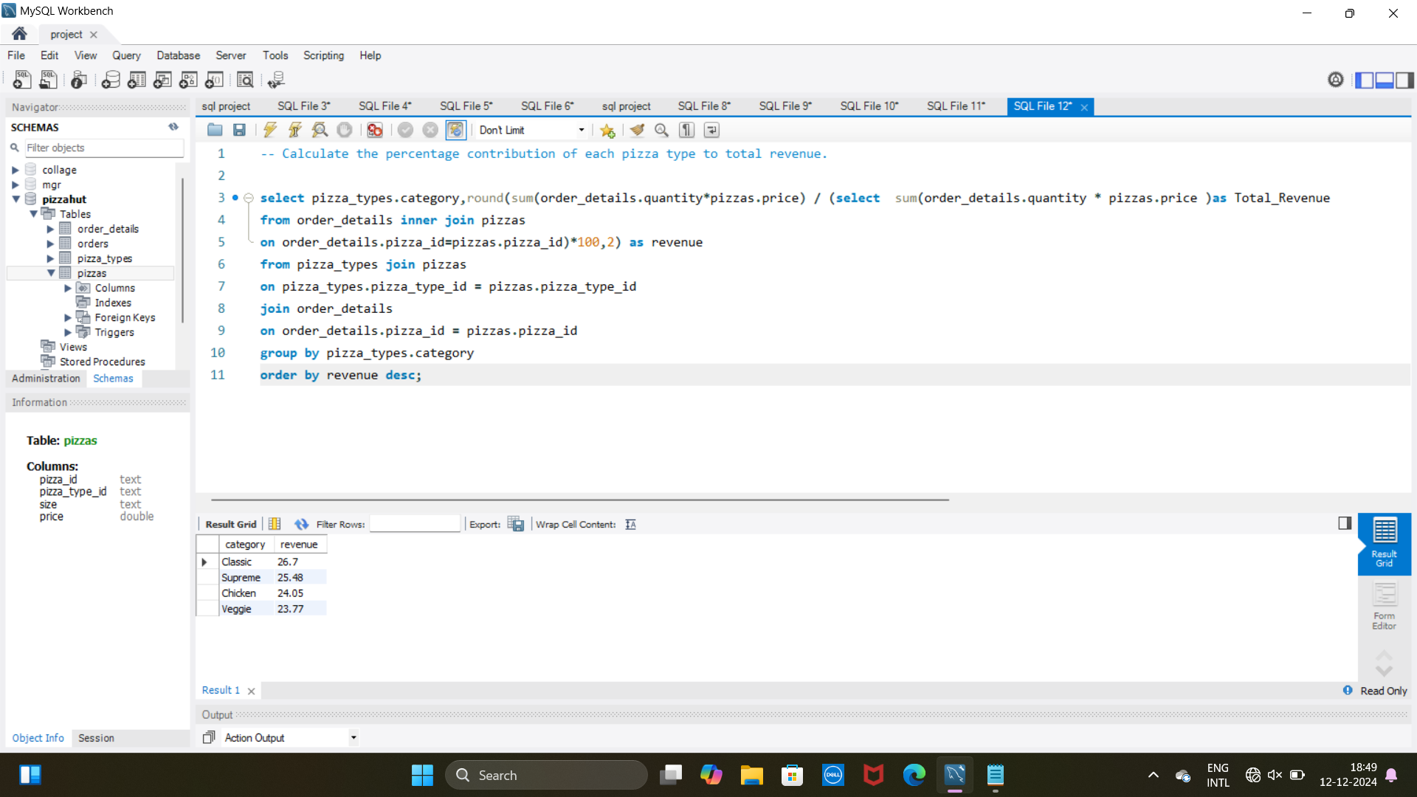
10. Calculate the percentage contribution of each pizza type to
total revenue. Analyze the cumulative revenue generated over time.

Slide 14

Thank you for your attention!

